Slide 1
YELLOW TAXI VS.
UBER & LYFT
BIG DATA · GROUP PROJECT · CRISP-DM
Where, when and at what price can New York's taxis still compete?
287 million trips, NYC 2025
Universidad de La Sabana · Big Data · October 10, 2026 · [Team names]
Notes:
Good morning. Our project analyses every Yellow Taxi, Uber and Lyft trip in New York City in 2025, about 287 million trips after cleaning. Our own angle is the competition between the traditional taxi and the app services. In the next ten minutes I will walk through the question, the pipeline we built with Prefect, Dask, AWS and Grafana, the main findings and our conclusions.

Slide 2
Dataset, objective and unit of analysis
A · BUSINESS UNDERSTANDING
Objective
Unit of analysis
Target variable
Compare Yellow Taxi with Uber and Lyft on demand, price and tipping by zone, hour and month, and predict which trips a taxi serves.
One completed passenger trip. One row = one trip.
is_taxi = 1 if the trip was a Yellow Taxi, 0 if Uber or Lyft.
6.8 GB
292 M
2 sources
+2 context
24 monthly Parquet files, 2025
raw trip records
Yellow Taxi + High Volume FHV
taxi zones, daily weather
Source: NYC Taxi & Limousine Commission, TLC Trip Record Data · Open-Meteo archive · 2 / 10
Notes:
The data is the official trip record data of the New York City Taxi and Limousine Commission. We use all twelve months of 2025 for two sources: Yellow Taxi and the High Volume For-Hire Vehicles, which are Uber and Lyft. Together that is 6.8 gigabytes and 292 million raw records, far above the 1.5 gigabyte requirement. The unit of analysis is one trip. Our target variable is is_taxi: was this trip served by a yellow taxi or by an app. As additional context we joined the taxi zone lookup, which turns zone IDs into boroughs, and daily weather for Central Park.

Slide 3

One recurring pipeline from raw files to the dashboard
D · E · F · G · ARCHITECTURE
TLC files
Prefect flow
AWS RDS
Grafana
24 Parquet files, 6.8 GB, stay local
discover new months → context data → clean with Dask → 8 quality rules → aggregate with Dask → load
PostgreSQL, only KPI tables, quality log, run log
15-panel management dashboard
Result table in AWS | Grain | Rows
service_month_kpi | month × service | 36
zone_month_kpi | month × pickup zone × service | 9,362
hour_weekday_kpi | month × weekday × hour × service | 6,048
daily_kpi (+ weather) | day × service | 1,095
Code: github.com/carlo120702/nyc-taxi-vs-uber-lyft · 3 / 10
Notes:
This is the architecture. The raw files never leave the laptop. A Prefect flow with six tasks finds months that are not yet in the database, loads the context data, cleans and harmonises the two different schemas in parallel with Dask, runs eight data quality rules per file, aggregates with Dask and loads only the results into PostgreSQL on AWS RDS. Grafana reads from RDS. The flow is incremental: a second run reports no new files, and a new month is processed on its own. The first full run took about six minutes for the analysis and load. All tables store sums, so Grafana can re-aggregate any time range correctly.

Slide 4
Taxi meter data needs far more cleaning than app data
B · C · DATA QUALITY
Share of raw rows | Yellow Taxi | Uber / Lyft
Negative fare (refunds) | 5.8 % | 0.0 %
Zero distance | 2.9 % | 0.0 %
Duration < 1 min or > 3 h | 2.3 % | 0.0 %
Removed in total | 9.7 % | 0.2 %
16 / 192
quality checks raised a warning, all for Yellow Taxi. Negative fares rose from 4 % in January to 9.5 % in November.
Also structural, not errors: taxi cash tips are not recorded, and the meter has no request time or driver pay. These gaps are documented, not imputed.
292.3 M raw rows → 287.1 M clean trips · 4 / 10
Notes:
Before the analysis we cleaned the data with explicit rules: trips outside the file's month, durations under one minute or over three hours, zero or over 100 miles, zero or negative fares and speeds above 80 miles per hour. The striking finding is the difference between the sources. Almost ten percent of the yellow taxi rows had to be removed, but only 0.2 percent of the app trips. The main reason is negative fares, which are refunds and voids stored as separate rows. Their share rises during the year, which the Prefect quality checks flagged automatically in 16 of 192 checks. The cause is not explained by the data itself, which is a point where we would need additional context from the TLC.

Slide 5
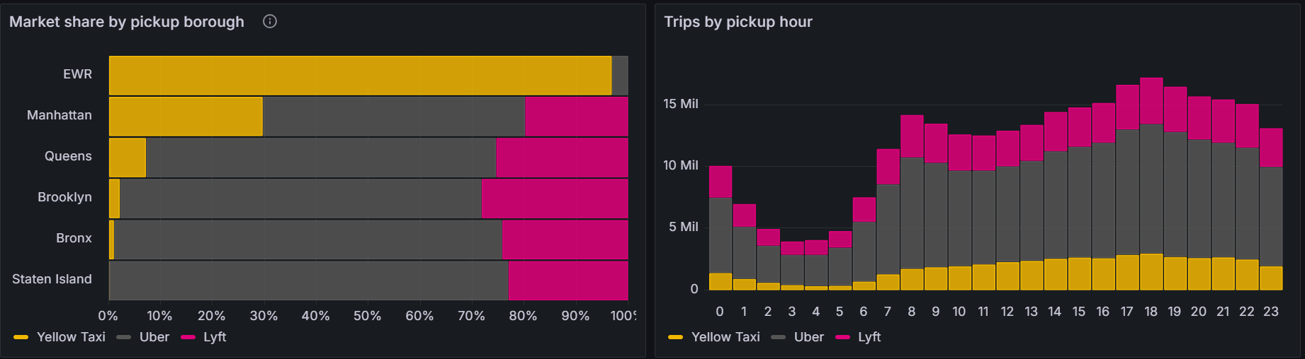
Taxis serve 15 % of all trips, but about 30 % in Manhattan
B · MARKET STRUCTURE 2025
15.3 %
61.3 %
23.4 %
Yellow Taxi · 44.0 M trips
Uber · 175.9 M trips
Lyft · 67.2 M trips
Share of 287.1 M clean trips · Grafana dashboard, data in AWS RDS · 5 / 10
Notes:
Here is the market. Uber has 61 percent of all trips, Lyft 23 and the yellow taxi only 15 percent. The share is stable across the year, between 14 and 16 percent per month. But the city-wide number hides where taxis still matter. In Manhattan, where street hails are allowed everywhere, taxis serve about 30 percent of trips, and in some zones such as Central Park or the Upper East Side more than half. In Queens it is about 7 percent, in Brooklyn and the Bronx almost nothing. On the right you see demand by hour: all services peak in the evening around 6 pm. So management should always look at market share by zone, not only city-wide.

Slide 6
Taxis are cheaper on short trips and earn five times the tips
B · PRICE AND TIPS
Average base fare (USD) by trip distance
Distance | Taxi | Uber | Lyft
under 1 mi | 8.44 | 10.63 | 8.61
1 to 2 mi | 12.40 | 14.19 | 12.88
2 to 3 mi | 17.31 | 19.24 | 17.52
3 to 5 mi | 22.93 | 24.42 | 23.22
5 to 10 mi | 33.81 | 34.57 | 33.72
10 to 20 mi | 59.41 | 58.54 | 57.43
Tip rate on card payments
22.0 %
Yellow Taxi, vs. 5.0 % Lyft and 4.2 % Uber
Taxi cash tips are not recorded, so only card payments are compared.
Base fare = before tips, taxes and surcharges · Taxi trips are shorter (3.5 vs. 5.1 mi) · 6 / 10
Notes:
On price we compare the base fare before tips, taxes and surcharges, because the surcharges differ by law. Up to five miles the taxi is cheaper than Uber in every distance band, on trips under one mile by about 20 percent. Lyft is almost at taxi level. On longer trips the difference disappears. One caveat: per mile over all trips the taxi looks more expensive, 5.71 dollars against 5.42 for Uber, but only because taxi trips are much shorter on average, and short trips are always more expensive per mile. The biggest difference is in tips. Taxi passengers paying by card tip 22 percent, app users only 4 to 5 percent, probably because the taxi payment screen suggests 20 to 30 percent.

Slide 7
Place and time predict a taxi trip well, the weather does not
B · C · TARGET VARIABLE AND CONTEXT DATA
Target is_taxi
Baseline model
Rainy days
15.3 %
0.867
15.4 %
positive class: imbalanced, so ROC-AUC and PR-AUC instead of accuracy
ROC-AUC, gradient boosting on 500 k trips. PR-AUC 0.51 vs. 0.15 at random.
taxi share on days with 5 mm+ rain, vs. 15.3 % on dry days: no shift
Features known at pickup: hour, weekday, month, pickup and drop-off borough, service zone, distance, airport, rain, temperature. Fare, tip and duration are excluded to avoid leakage.
Context data: TLC taxi zone lookup, Open-Meteo daily weather for Central Park · 7 / 10
Notes:
Our target variable is is_taxi. Only 15 percent of trips are positive, so the target is imbalanced and we evaluate with ROC-AUC and PR-AUC, not accuracy. As a feasibility check for the modelling phase we trained a gradient boosting model on a sample of half a million trips, using only features that are known when the trip starts. Fare, tip and duration are excluded because they are a consequence of the service chosen. The model reaches a ROC-AUC of 0.87, so place and time already separate taxi trips well. The weather data was our additional context: rainy days increase demand slightly for all services, but the taxi share does not change.

Slide 8
Fewer, larger workers were 35 % faster
E · DASK CONFIGURATIONS
A · 2 workers × 4 threads × 6 GB
286 s
B · 4 workers × 2 threads × 3 GB
441 s
KPI aggregation (227 s vs. 335 s)
Descriptive statistics (59 s vs. 106 s)
Same 8 threads and 12 GB in both. Fewer processes exchange less data during group-bys. We made A the default. Lesson learned: partitions must fit the memory per worker, a whole month in one partition killed the workers.
Median of 2 runs over 287.1 M trips, 305 partitions · Intel i7, 32 GB RAM · 8 / 10
Notes:
For Dask we compared two cluster configurations with the same total resources, eight threads and twelve gigabytes: two big workers against four small ones. With two workers the full analysis over 287 million trips took 286 seconds, with four workers 441 seconds, so configuration A was about 35 percent faster. Our explanation is that group-bys exchange data between worker processes, and with fewer processes there is less to exchange. We therefore made A the default. We also learned the hard way that partition size must match worker memory: in our first run one Uber month was a single partition of several gigabytes and Dask killed the workers. Splitting by Parquet row group, at most one million trips per partition, solved it.

Slide 9
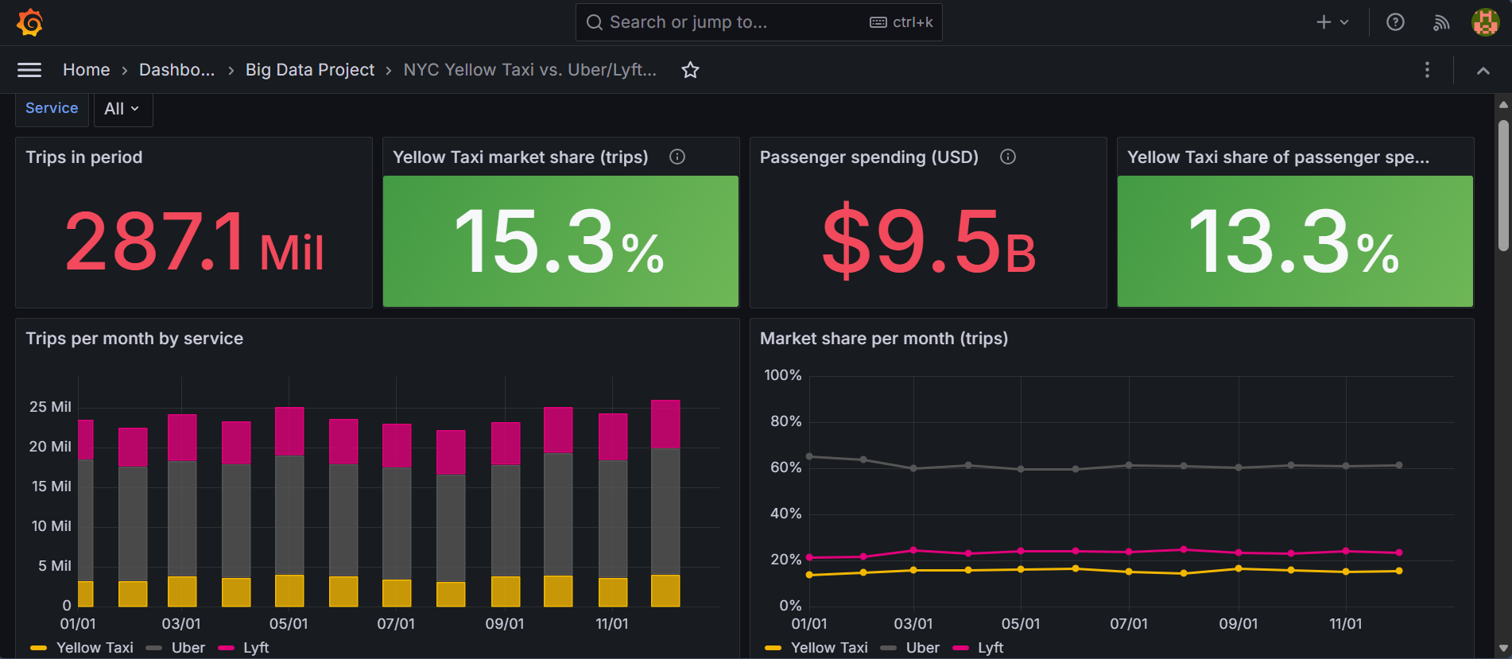
A management view on the AWS results
G · GRAFANA
15 panels on 4 AWS tables
Filter by service and time range
$9.5 B spent, taxis 13.3 %
ETL runs and quality checks shown live
Grafana 11 in Docker, PostgreSQL data source on AWS RDS · 9 / 10
Notes:
This is the Grafana dashboard for management. It reads only the aggregated tables in AWS RDS. The top row shows the headline numbers: 287 million trips, a taxi market share of 15.3 percent, 9.5 billion dollars of passenger spending of which taxis receive 13.3 percent. Below are trips and market share per month. Further down, not visible here, are market share by borough, demand by hour, price per mile, tip rates, the zones where taxis are strongest, waiting time and driver share for Uber and Lyft, daily trips against rainfall, and the status of every Prefect run with its quality checks. Every panel can be filtered by service and time range.

Slide 10
The taxi is a Manhattan and airport product
H · CONCLUSIONS
Niche, not gone
Competitive on short trips
15 % of trips city-wide, about 30 % in Manhattan, more than half in some zones.
Up to 20 % cheaper than Uber under 1 mile, and 22 % card tips for drivers.
Predictable
Data quality differs
Place and time alone reach ROC-AUC 0.87. Weather does not shift the share.
9.7 % of taxi rows removed vs. 0.2 % of app rows. Refunds need TLC context.
Next: full model with zone-level features, add 2024 for a trend, and schedule the Prefect flow monthly.
Code and notebook: github.com/carlo120702/nyc-taxi-vs-uber-lyft · 10 / 10
Notes:
To conclude. First, the yellow taxi is not gone but has become a niche: a Manhattan and airport product. Second, it is still competitive on short trips, where it is cheaper than Uber, and drivers earn much higher tips. Third, whether a trip is a taxi trip is highly predictable from place and time alone, while the weather does not change the market split. Fourth, the data quality of the taxi meter is clearly worse than the app data, and the rising share of refunds is something we would need to clarify with the TLC. Next steps would be a full model with zone-level features, adding 2024 to see the trend, and running the Prefect flow on a monthly schedule, since the TLC publishes a new file every month. Thank you, we are happy to take questions.

